Slide 1
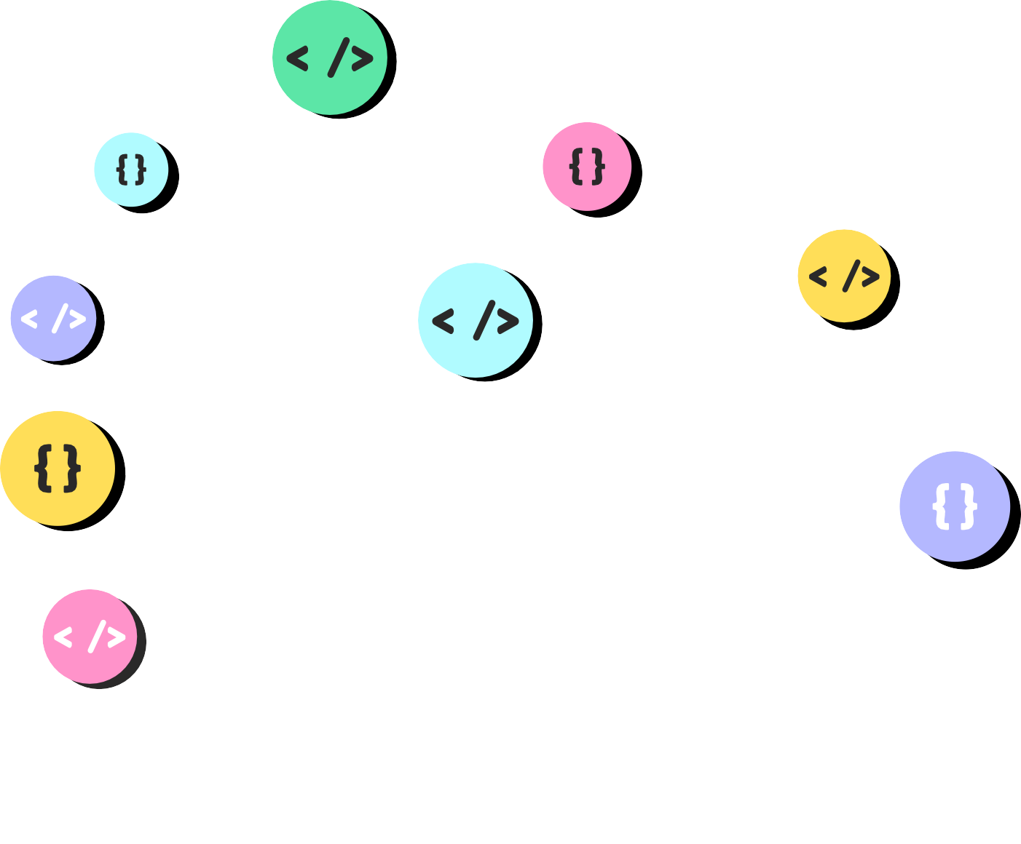
THE
DOM

Slide 2


Slide 3


Slide 4


Slide 5


Slide 6


Slide 7







MAKE SURE YOU ARE COMFORTABLE WITH BASIC HTML & CSS!

Slide 8



DOCUMENT
OBJECT M ODEL

Slide 9

WHAT IS IT?
The DOM is a Java Script representation of a
webpage.
It' s your JS " window" into the contents of a webpage It' s just a bunch of
objects that you can interact with via JS.

Slide 10





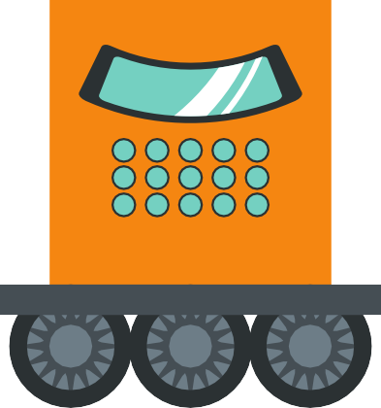


HTML+CSS Go In...
JS Objects Come Out

Slide 11

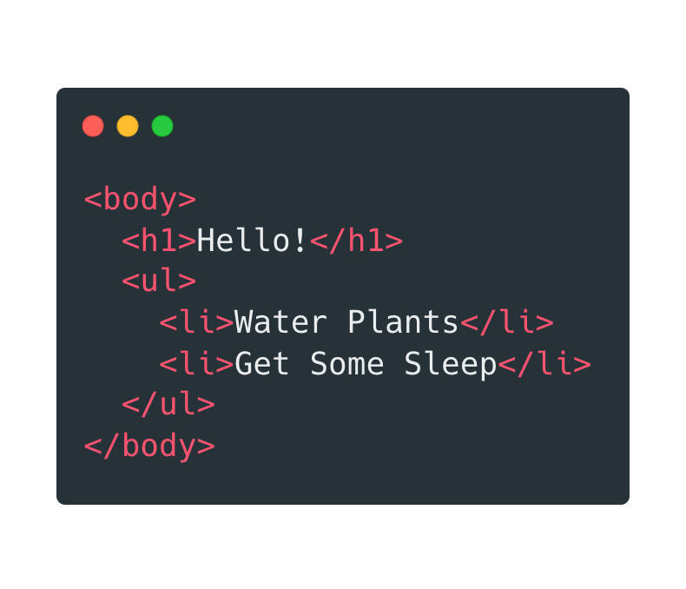


I'm an object!
DOCU MENT
BODY
Me too!
H 1
UL
LI LI
JS Objects Come Out
HTML+CSS Go In...

Slide 12

DOCUMENT
Let's start with the...
OBJECT M ODEL
I have nothing to do with the DOM but I look cool!

Slide 13








DOCU MENT
DOCUMENT
BODY
The document object is our entry point into the world of the DOM. It contains representations of all the content on a page, plus tons of useful methods and properties
H 1
UL
LI
LI

Slide 14




SELECTING

Slide 15


MANIPULATE
SELECT

Slide 16

SELECTING
getElementById getElementsByTagName getElementsByClassName

Slide 17
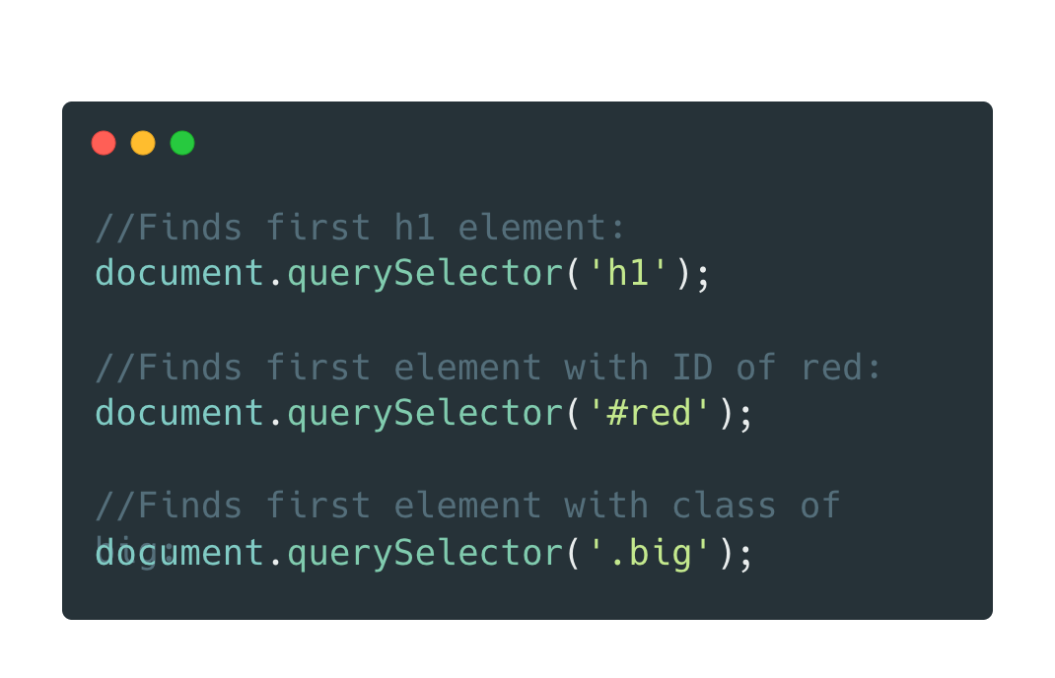
query Selector
A newer, all-in-one method to select a single element. Pass in a CSS selector

Slide 18

query Selector All
Same idea , but returns a collection of matching elements

Slide 19


MANIPULATE
SELECT

Slide 20


Slide 21

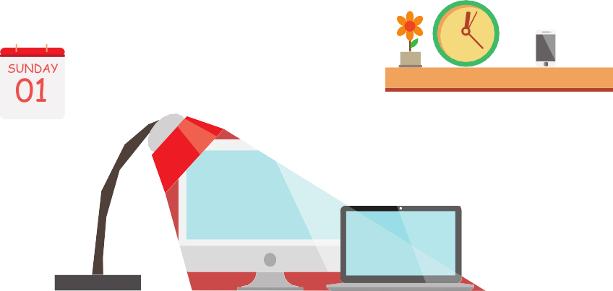


PROPERTIES & METHODS
( the important ones)
classList getAttribute() setAttribute() appendChild() append() prepend() removeChild() remove() createElement
innerText textContent innerHTML value parentElement children nextSibling previousSibling style

Slide 22


EVENTS
Responding to user i nputs and actions!

Slide 23

A SMALL TASTE
clicks drags drops hovers scrolls
form submission key presses focus/blur
mouse wheel double click copying pasting audio start screen resize printing

Slide 24
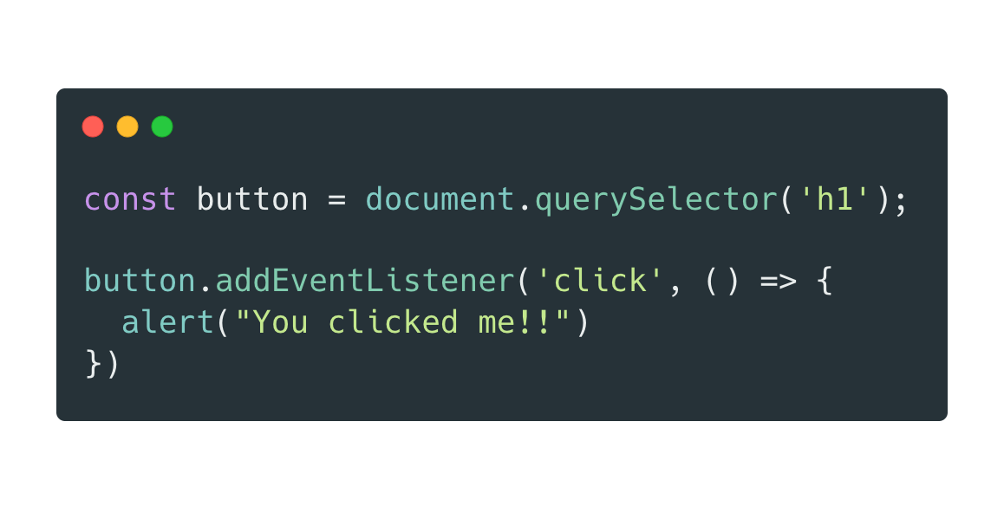
add Event Listener
Specify the event type and a callback to run

